Slide 1
Mill Grove
Christmas Day Games 2020
Following tradition, here are the Christmas Day Games! Normally they would come after the opening of the presents (to Mill Grove) and would involve quizzes and practical tasks like Chinese Laundry and Pictionary. Obviously this year it is an adapted version, but we hope you still have fun with it!

Slide 2
Round 1 – Scavenger Hunt (1 point for each item you are able to find)
£7.70 in coins
6 different socks
A cracker toy
A photo of someone connected to Mill Grove
A cracker joke
An ID card
A shoelace
3 Keyrings
An unbroken Christmas hat

Slide 3
Round 2 – Sports 2020
How many world titles has O’Sullivan now won in Snooker?
Name any of the sports Tokyo were planning to introduce to the Olympics
Who captained Liverpool to their first Premier League title?
Who won Sports Personality of the Year?
How many formula 1 World Titles has Hamilton now won?
Messi scored his 644th goal for one club – who had held the record for most goals for one club before him?
Who got promoted to the Premier League this year?
Which basketball team did the late
Koby Brant play for?

Slide 4
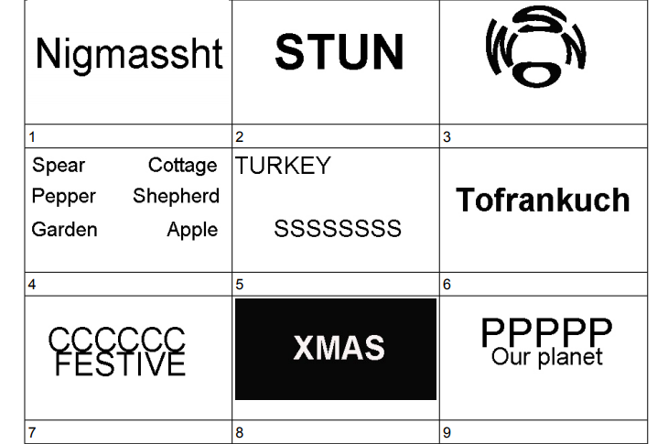
Round 3 – Christmas Dingbats

Slide 5
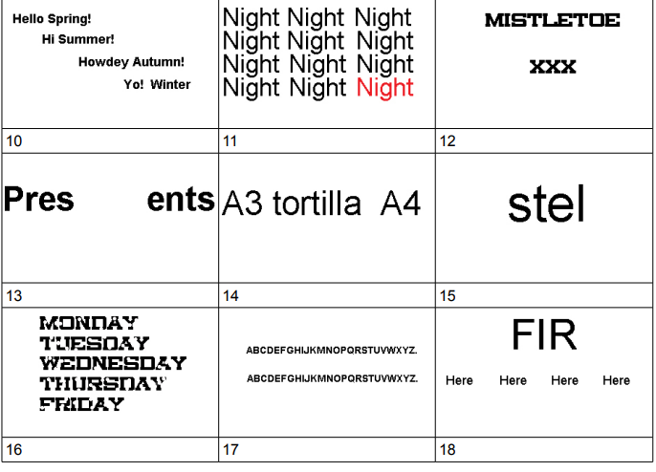

Slide 6
Round 4 – Film and TV 2020
QUIZ was about Major Charles Ingram – but why was he famous?
Where was the Eurovision Song Contest meant to be held this year?
Who did Matt Lucas replace on the Great British Bake Off?
Taskmaster moved to Channel 4 this year – what channel was it on before?
What year is the new Wonder Woman film set in?
Which classic Jedi appeared in the Mandalorian series finale?
What was the name of the James Bond film that was meant to come out this year?
Which cartoon show began its 32nd series
this year?

Slide 7
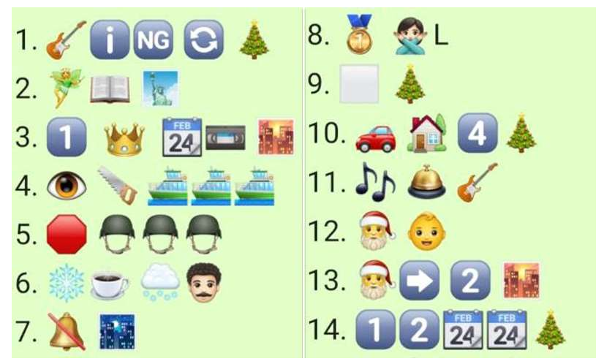
Round 5 – Christmas Song Emoji

Slide 8
Round 6 – Christmas Quiz
How many presents are given in total in The 12 Days of Christmas?
How many of Santa’s reindeers begin with the letter D?
If you are born on Christmas day, what is your star sign?
What is the best selling Christmas single of all time?
What colour are mistletoe berries?
What colour did Santa wear before he changed to red?
Which country started the Christmas tree tradition?
When do the 12 days of Christmas
Start?

Slide 9
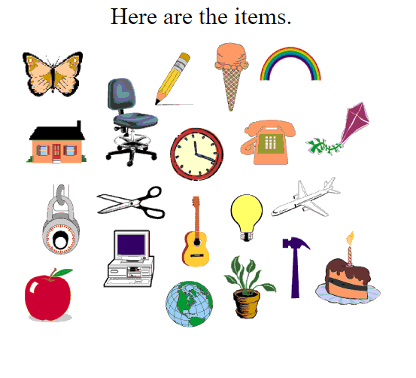
Round 7 – Memory Game
Look at the picture for 30 seconds!

Slide 10
What time did it say on the clock?
What colour was the ice cream?
How many leaves were on the plant?
How many objects were there in total?
How many windows were on the house?
What continent was the globe showing?
How many wheels did the chair have?
How many food items were there?

Slide 11
Round 8 – News 2020
What did Boris Johnson name his new child?
What excuse did Dominic Cummings give for driving his car?
How did Donald Trump ludicrously suggest we should fight the virus?
What was the name of the rocket which took Bob Behnken to space in the first space ‘taxi’?
What was voted the greatest Eurovision song in history?
Which United Nations body was awarded the Nobel Peace Prize?
Victory in which state saw Joe Biden cross the line to become President?
Which lockdown related word was awarded ‘word of the year’ by the Oxford Dictionary?

Slide 12
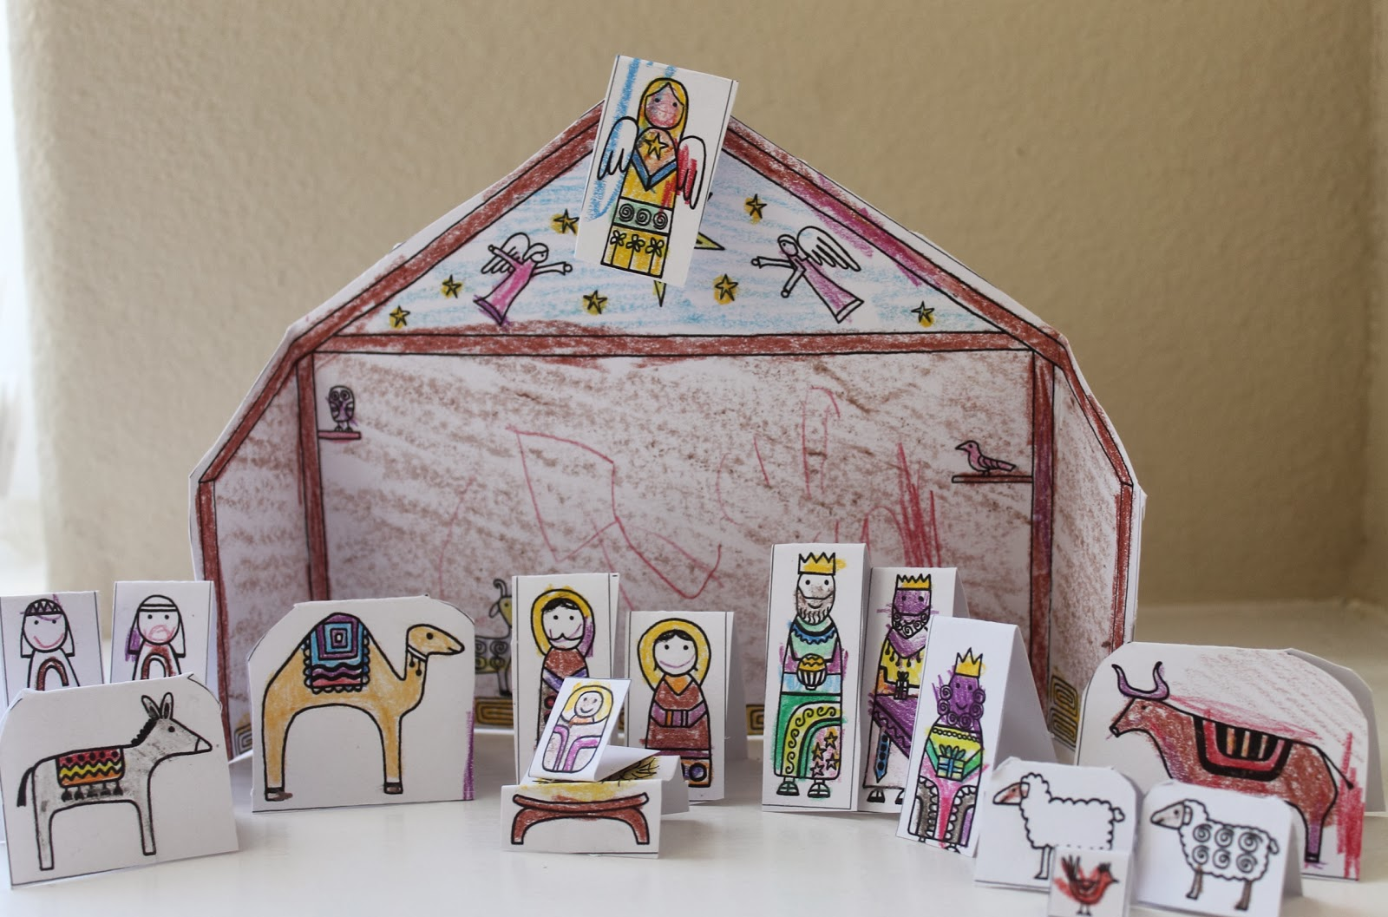
Round 9 - Nativity
We always have a making task in the Christmas Day games – you have 15 minutes to create a nativity scene. You could make it out of people from your household; you could create it out of paper or you could really think outside the box! Have a go!

Slide 13
Round 10 – Pantomime Quiz
What is the name of Aladdin’s mother?
Mr. Smee comes from what Pantomime?
What is the name of the male servant in Cinderella?
Which pantomime did Mill Grove perform last year?
How many years is Sleeping Beauty cursed to sleep for?
What is the name of the Mill Grove Pantomime cow?
Dame Trott comes from which Pantomime?
Name two ways the Queen tries to curse
Snow White

Slide 14
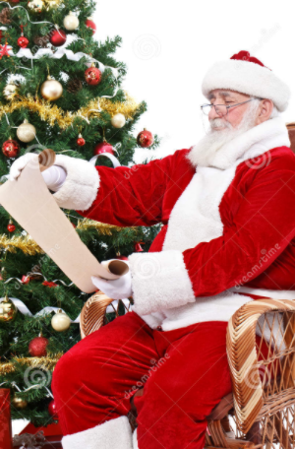
Round 11 – Christmas lists (1 point for each item you get on your list)
Characters in A Christmas Carol
Squares on a traditional Monopoly board
Ingredients in Mary Berry’s Mince Pie recipe
Central Line Underground stations
Pantomimes performed at Mill Grove
Christmas Carols

Slide 15
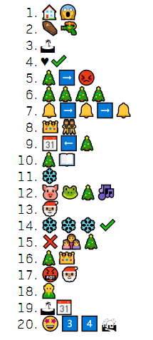
Round 12-
Christmas
Film
Emojis

Slide 16
Round 13 – Music 2020
Which former One Direction singer released ‘Watermelon Sugar?’
Which musical comedian won Strictly Come Dancing?
Who announced they were leaving Little Mix this year?
What is the biggest selling single of the year?
What food item does the Christmas Number 1 sing about?
Which girl band member won the Masked Singer this year?
Who became the first artist to have a top 5 selling album in 8 consecutive decades?

Slide 17
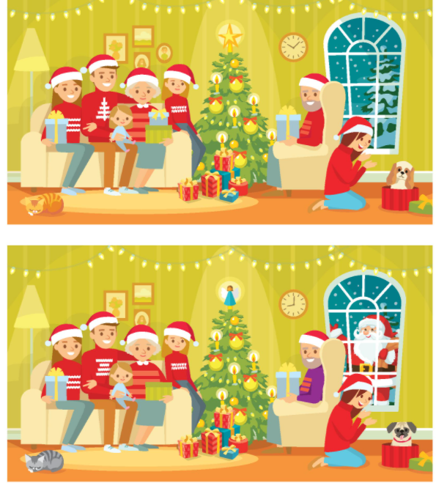
Round 14 – Christmas Spot the Difference

Slide 18
Round 15 – A Mill Grove Christmas
What is the name given to the orange with a candle in?
What does someone say before people open the presents on Christmas day?
How is pudding announced on Boxing Day dinner?
Which meal does Santa arrive on Christmas Day?
What time is the Queen’s Speech?
Which two teams compete in the Boxing Day Football Match?
Whose songs are played during the Boxing day games?
Name 8 Boxing Day games

Slide 19
Final Round
Normally, we would play Pictionary as our last game on Christmas Day – here is a link for you to play your own version of Pictionary!
https://www.thegamegal.com/wp-content/uploads/2011/12/Christmas.pdf

Slide 20
We hope you enjoyed the Christmas Day Games – let us know how you found them!

